Slide 1
CSE 477: Introduction to Computer Security
Lecture – 10
Course Teacher: Dr. Md Sadek Ferdous
Assistant Professor, CSE, SUST
E-mail: ripul.bd@gmail.com

Slide 2
Digital signature
A digital signature is a way for an entity to demonstrate the authenticity of a message by binding its identity with that message
Alice uses her private key with a signature algorithm to produce a digital signature, S_{Alice}(M), for a message, M
Given Alice’s public key, the message, M, and Alice’s signature, S_{Alice}(M)
Bob verifies Alice’s signature on M

Slide 3
Digital signature: properties
Three important properties that we would like to have for a digital- signature scheme are the following:
Nonforgeability: It should be difficult for an attacker, Eve, to forge a signature, S_{Alice}(M), for a message, M, as if it is coming from Alice
Nonmutability: It should be difficult for an attacker, Eve, to take a signature, S_{Alice}(M), for a message, M, and convert S_{Alice}(M) into a valid signature on a different message, N
Non-repudiation: If a digital-signature scheme achieves these two properties, then it actually achieves nonrepudiation
It should be difficult for Alice to claim she didn’t sign a document, M, once she has produced a digital signature, S_{Alice}(M), for that document

Slide 4
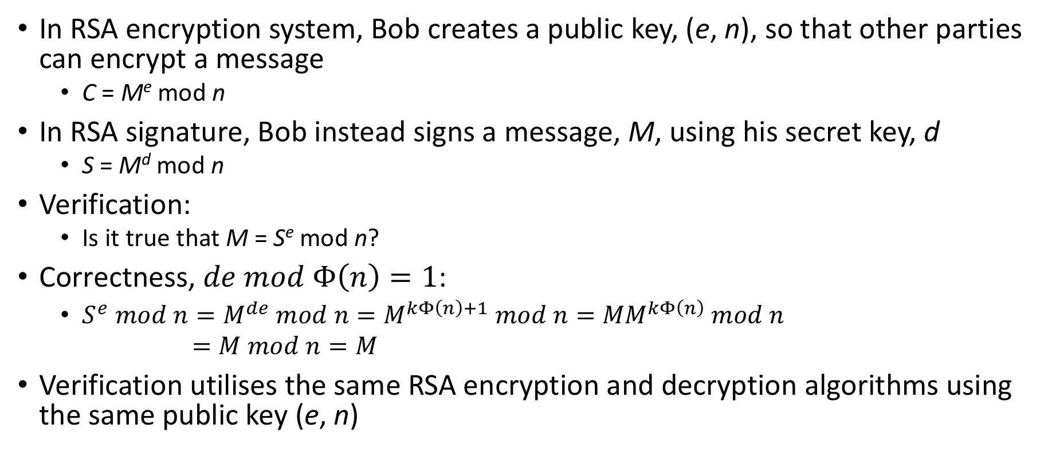
RSA signature
In RSA encryption system, Bob creates a public key, (e, n), so that other parties can encrypt a message
C = Me mod n
In RSA signature, Bob instead signs a message, M, using his secret key, d
S = M^{d} mod n
Verification:
Is it true that M = S^{e} mod n?
Correctness, $de mod Φ\left(n\right)=1$:
$S^{e} mod n=M^{de} mod n=M^{kΦ\left(n\right)+1} mod n={MM}^{kΦ\left(n\right)} mod n$
$=M mod n=M$
Verification utilises the same RSA encryption and decryption algorithms using the same public key (e, n)

Slide 5
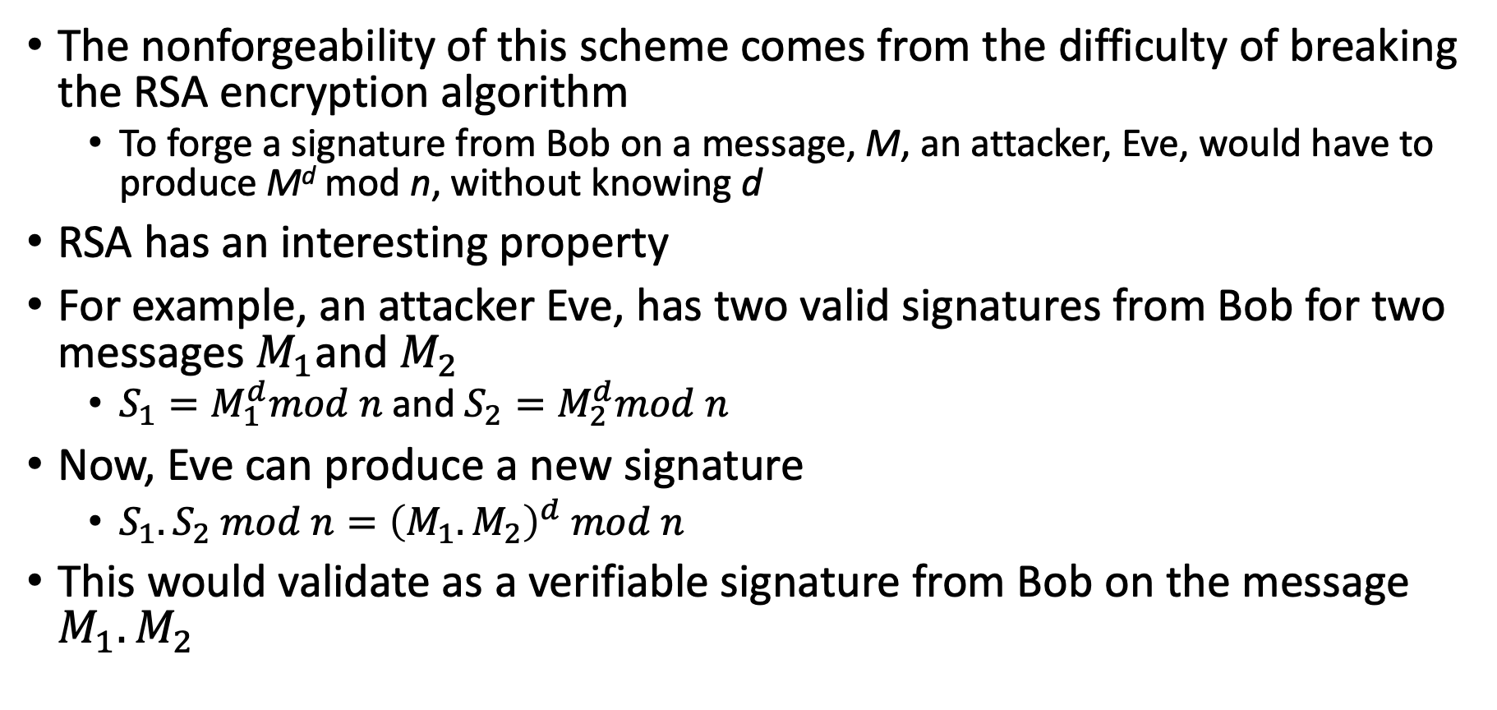
RSA signature: security
The nonforgeability of this scheme comes from the difficulty of breaking the RSA encryption algorithm
To forge a signature from Bob on a message, M, an attacker, Eve, would have to produce M^{d} mod n, without knowing d
RSA has an interesting property
For example, an attacker Eve, has two valid signatures from Bob for two messages $M_{1}$and $M_{2}$
$S_{1}=M_{1}^{d}mod n$ and $S_{2}=M_{2}^{d}mod n$
Now, Eve can produce a new signature
$S_{1}.S_{2} mod n={\left(M_{1}.M_{2}\right)}^{d} mod n$
This would validate as a verifiable signature from Bob on the message $M_{1}.M_{2}$

Slide 6
Hash function + Digital signature
For practical purposes, the above descriptions of the RSA digital-signature schemes are not what one would use in practice
The scheme is inefficient if the message, M, being signed is very long
For instance, RSA signature creation involves an encryption of the message, M, using a private key
For this reason, real-world digital-signature schemes are usually applied to cryptographic hashes of messages, not to actual messages
Moreover, signing a hash value is more efficient than signing a full message

Slide 7
Outline
Cryptographic protocols
These lectures have been created from several other lectures whose references are given below:
Foundations of Computer Security by Dr. Bill Young, University of Texas at Austin. The lecture series can be found at
https://www.cs.utexas.edu/~byoung/cs361/lecture1.pdf
Cryptographic protocol lecture by Prof. Dr.-Ing. Georg Carle, University of University of Tübingen, Germany
http://www.ccs-labs.org/~dressler/teaching/netzsicherheit-ws0304/07_CryptoProtocols_2on1.pdf

Slide 8
Thought experiment
Consider the following scenario
Your friend Ivan lives in a repressive country where the police spy on everything and open all the mails
You need to send a valuable object to Ivan
How can you get the item to Ivan securely?
How do you think you can do it physically?

Slide 9
Thought Experiment
You will need a box with a hasp big enough for several locks
Put the item into the box, attach your lock to the hasp, and mail the box to Ivan
Ivan adds his own lock and mails the box back to you
You remove your lock and mail the box back to him
He now removes his lock and opens the box
https://www.homedepot.com/p/Master-Lock-Steel-Lockout-Hasp-MLK420/206322471
http://www.ifam.es/wp-content/uploads/2015/06/portacandado-pmi-ifam.jpg

Slide 10
Cryptographic protocols
The procedure just described could be regarded as a protocol
Almost everything that occurs on the Internet occurs via a protocol
An Internet protocol is a structured dialogue among two or more parties using the Internet
controlling the syntax, semantics, and synchronisation of communication, and
designed to accomplish a communication-related function or goal
A cryptographic protocol is a protocol using cryptographic mechanisms to accomplish some security-related function

Slide 11
Cryptographic protocols
All cryptographic protocols share the following characteristics
several principals are exchanging messages
they are attempting to accomplish some security-related function
they are operating in a hostile and insecure environment
The protocol must be robust and reliable in the face of a determined attacker

Slide 12
Goals
Among the goals of cryptographic protocols are the following
Unicity: secret shared by exactly two parties
Integrity: message arrived unmodified
Authenticity: message claim of origin is true
Confidentiality: message contents are inaccessible to an eavesdropper
Non-repudiation of origin: sender can’t deny sending
Non-repudiation of receipt: receiver can’t deny receiving

Slide 13
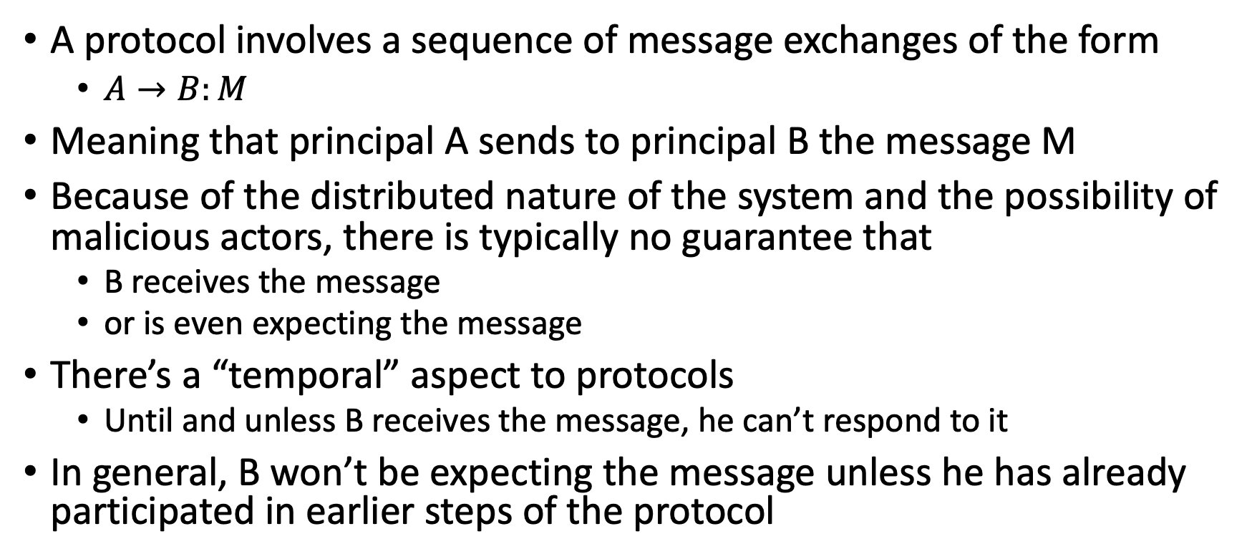
Cryptographic protocols
A protocol involves a sequence of message exchanges of the form
$A→B:M$
Meaning that principal A sends to principal B the message M
Because of the distributed nature of the system and the possibility of malicious actors, there is typically no guarantee that
B receives the message
or is even expecting the message
There’s a “temporal” aspect to protocols
Until and unless B receives the message, he can’t respond to it
In general, B won’t be expecting the message unless he has already participated in earlier steps of the protocol

Slide 14
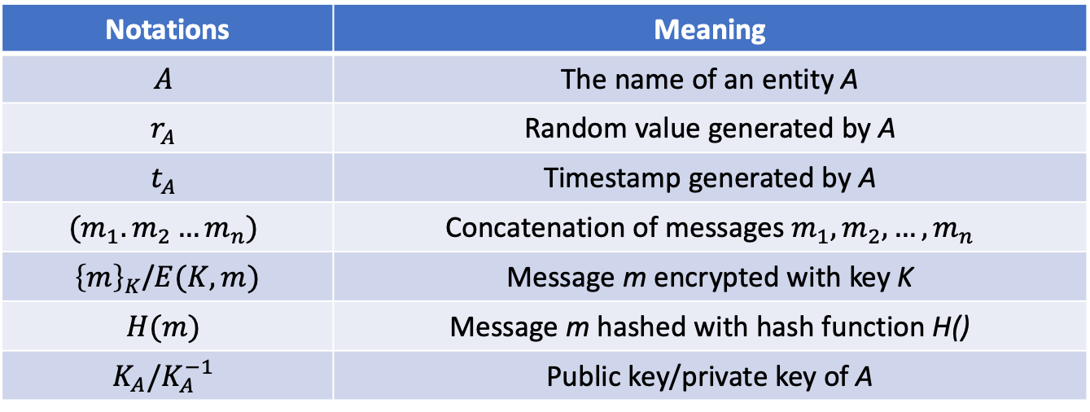
Other notations
Notations | Meaning
$$A$$ | The name of an entity A
$$r_{A}$$ | Random value generated by A
$$t_{A}$$ | Timestamp generated by A
$$(m_{1}.m_{2}…m_{n})$$ | Concatenation of messages $m_{1},m_{2},…, m_{n}$
${\left\{m\right\}}_{K}$/$E(K,m)$ | Message m encrypted with key K
$$H(m)$$ | Message m hashed with hash function H()
$$K_{A}/K_{A}^{−1}$$ | Public key/private key of A

Slide 15
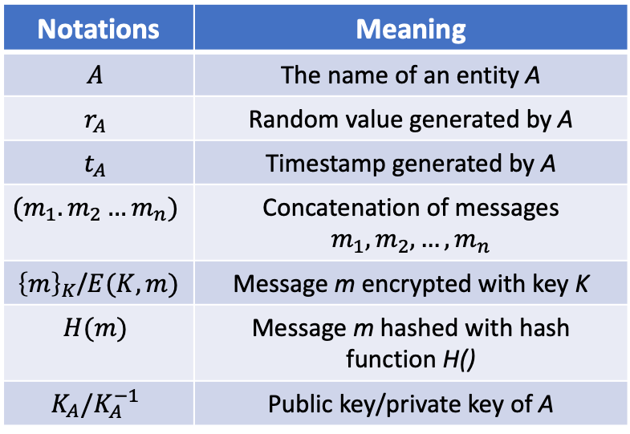

Cryptographic protocols: an example
Notations | Meaning
$$A$$ | The name of an entity A
$$r_{A}$$ | Random value generated by A
$$t_{A}$$ | Timestamp generated by A
$$(m_{1}.m_{2}…m_{n})$$ | Concatenation of messages $m_{1},m_{2},…, m_{n}$
${\left\{m\right\}}_{K}$/$E(K,m)$ | Message m encrypted with key K
$$H(m)$$ | Message m hashed with hash function H()
$$K_{A}/K_{A}^{−1}$$ | Public key/private key of A
$A→B:{\left\{{\left\{K\right\}}_{K_{a}^{−1}}\right\}}_{K_{b}}$
$B→A:{\left\{{\left\{K\right\}}_{K_{b}^{−1}}\right\}}_{K_{a}}$
Can you guess what is the protocol here?

Slide 16
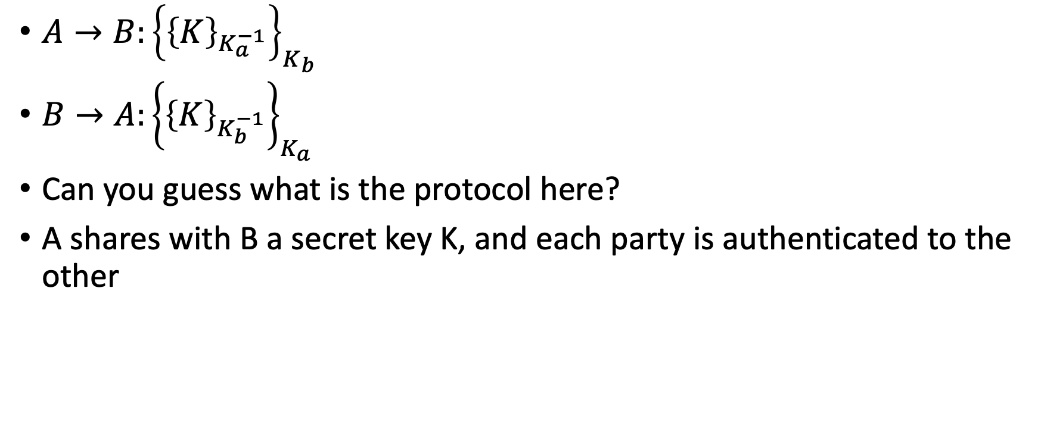
Cryptographic protocols: an example
$A→B:{\left\{{\left\{K\right\}}_{K_{a}^{−1}}\right\}}_{K_{b}}$
$B→A:{\left\{{\left\{K\right\}}_{K_{b}^{−1}}\right\}}_{K_{a}}$
Can you guess what is the protocol here?
A shares with B a secret key K, and each party is authenticated to the other

Slide 17
Cryptographic protocols: attacks
This is a partial list of attacks on protocols:
Known-key attack: attacker gains some keys used previously and uses this info in some malicious fashion
Replay: attacker records messages and replays them at a later time
Impersonation: attacker assumes the identity of one of the legitimate parties in a network
Man-in-the-Middle: attacker interposes himself between two parties and pretends to each to be the other
Interleaving attack: attacker injects spurious messages into a protocol run to disrupt or subvert it

Slide 18
Cryptographic protocols: attackers
The designer of a protocol should assume that an attacker can access all of the traffic and interject his own messages into the flow
The protocol should be robust in the face of such a determined and resourceful attacker
Remember this, two questions to ask of any step in any protocol
What is the sender trying to say with this message?
What is the receiver entitled to believe after receiving the message?

Slide 19
Needham-Schroeder protocol
Many existing protocols are derived from one proposed by Needham and Schroeder (1978)
N-S is a shared-key authentication protocol designed to generate and propagate a session key
i.e., a shared key for subsequent symmetrically encrypted communication
Note that there is no public key infrastructure (PKI) in place

Slide 20
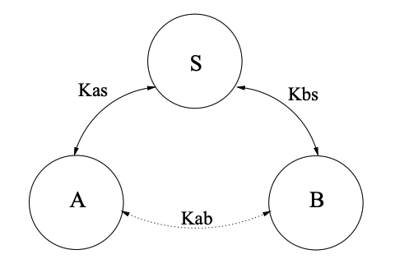
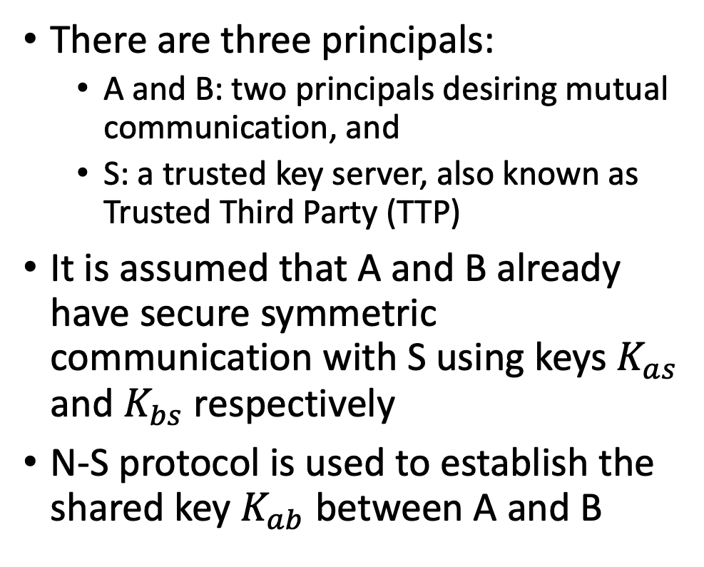
Needham-Schroeder protocol
There are three principals:
A and B: two principals desiring mutual communication, and
S: a trusted key server, also known as Trusted Third Party (TTP)
It is assumed that A and B already have secure symmetric communication with S using keys $K_{as}$ and $K_{bs}$ respectively
N-S protocol is used to establish the shared key $K_{ab}$ between A and B

Slide 21
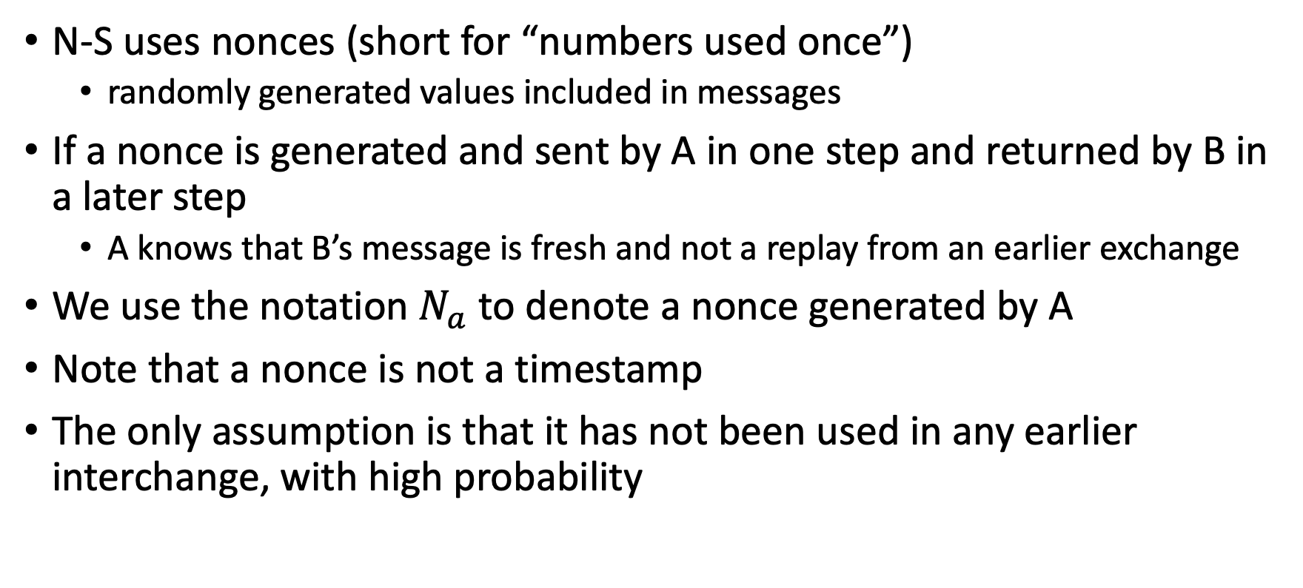
Needham-Schroeder protocol
N-S uses nonces (short for “numbers used once”)
randomly generated values included in messages
If a nonce is generated and sent by A in one step and returned by B in a later step
A knows that B’s message is fresh and not a replay from an earlier exchange
We use the notation $N_{a}$ to denote a nonce generated by A
Note that a nonce is not a timestamp
The only assumption is that it has not been used in any earlier interchange, with high probability

Slide 22

Needham-Schroeder protocol
$A→S:A, B, N_{a}$
$S→A:{\left\{N_{a},B, K_{ab}, {\left\{K_{ab},A\right\}}_{K_{bs}}\right\}}_{K_{as}}$
$A→B:{\left\{K_{ab},A\right\}}_{K_{bs}}$
$B→A:{\left\{N_{b}\right\}}_{K_{ab}}$
$A→B:{\left\{N_{b}−1\right\}}_{K_{ab}}$
Here, $N_{a}$ and $N_{b}$ are nonces

Slide 23
Needham-Schroeder protocol
Needham-Schroeder is a shared-key authentication protocol that has been very important historically
It illustrates:
the overall structure of protocols
that some principals (TTP) may have special roles to play
the usefulness of nonces

Slide 24
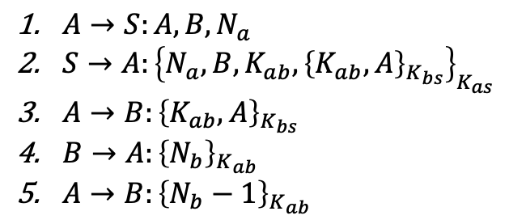
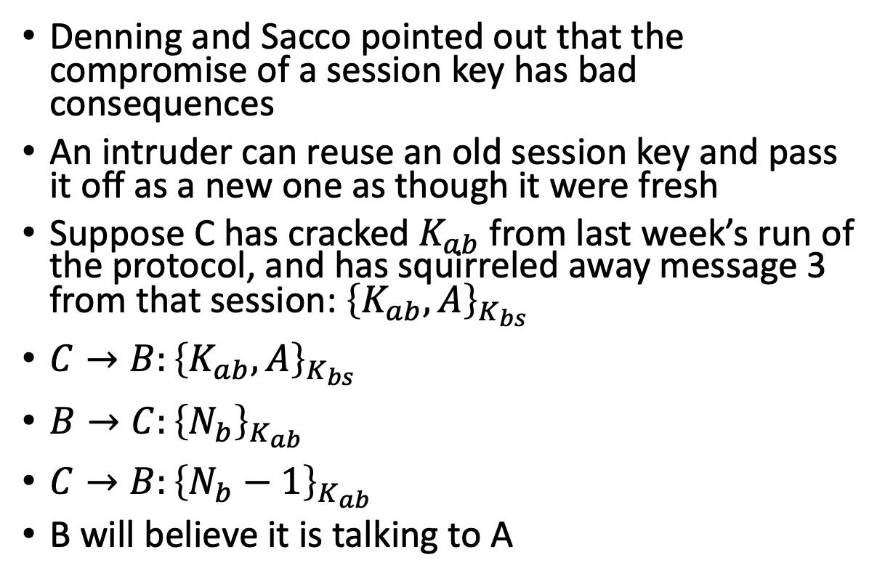
Flaws on Needham-Schroeder protocol
Denning and Sacco pointed out that the compromise of a session key has bad consequences
An intruder can reuse an old session key and pass it off as a new one as though it were fresh
Suppose C has cracked $K_{ab}$ from last week’s run of the protocol, and has squirreled away message 3 from that session: ${\left\{K_{ab},A\right\}}_{K_{bs}}$
$C→B:{\left\{K_{ab},A\right\}}_{K_{bs}}$
$B→C:{\left\{N_{b}\right\}}_{K_{ab}}$
$C→B:{\left\{N_{b}−1\right\}}_{K_{ab}}$
B will believe it is talking to A
$A→S:A, B, N_{a}$
$S→A:{\left\{N_{a},B, K_{ab}, {\left\{K_{ab},A\right\}}_{K_{bs}}\right\}}_{K_{as}}$
$A→B:{\left\{K_{ab},A\right\}}_{K_{bs}}$
$B→A:{\left\{N_{b}\right\}}_{K_{ab}}$
$A→B:{\left\{N_{b}−1\right\}}_{K_{ab}}$

Slide 25

Flaws on Needham-Schroeder protocol
Message 3 is not protected by nonces
There is no way for B to know if the $K_{ab}$ it receives is current
An intruder has unlimited time to crack an old session key and reuse it as if it were fresh
$A→S:A, B, N_{a}$
$S→A:{\left\{N_{a},B, K_{ab}, {\left\{K_{ab},A\right\}}_{K_{bs}}\right\}}_{K_{as}}$
$A→B:{\left\{K_{ab},A\right\}}_{K_{bs}}$
$B→A:{\left\{N_{b}\right\}}_{K_{ab}}$
$A→B:{\left\{N_{b}−1\right\}}_{K_{ab}}$

Slide 26
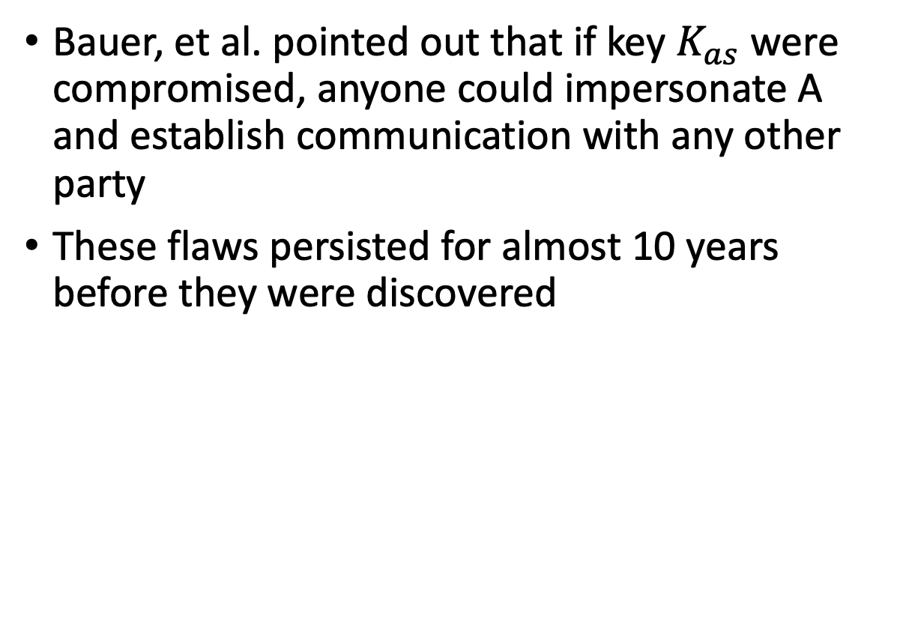
Flaws on Needham-Schroeder protocol
Bauer, et al. pointed out that if key $K_{as}$ were compromised, anyone could impersonate A and establish communication with any other party
These flaws persisted for almost 10 years before they were discovered
$A→S:A, B, N_{a}$
$S→A:{\left\{N_{a},B, K_{ab}, {\left\{K_{ab},A\right\}}_{K_{bs}}\right\}}_{K_{as}}$
$A→B:{\left\{K_{ab},A\right\}}_{K_{bs}}$
$B→A:{\left\{N_{b}\right\}}_{K_{ab}}$
$A→B:{\left\{N_{b}−1\right\}}_{K_{ab}}$

Slide 27
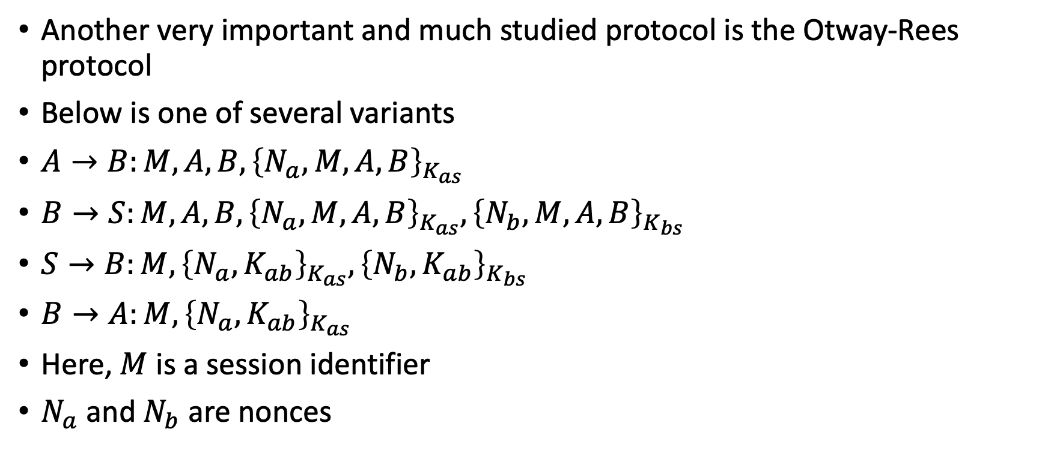
Otway-Rees protocol
Another very important and much studied protocol is the Otway-Rees protocol
Below is one of several variants
$A→B:M,A, B, {\left\{N_{a},M,A,B\right\}}_{K_{as}}$
$B→S:M,A, B, {\left\{N_{a},M,A,B\right\}}_{K_{as}},{\left\{N_{b},M,A,B\right\}}_{K_{bs}}$
$S→B:M,{\left\{N_{a},K_{ab}\right\}}_{K_{as}},{\left\{N_{b},K_{ab}\right\}}_{K_{bs}}$
$B→A:{M, \left\{N_{a}, K_{ab}\right\}}_{K_{as}}$
Here, $M$ is a session identifier
$N_{a}$ and $N_{b}$ are nonces

Slide 28
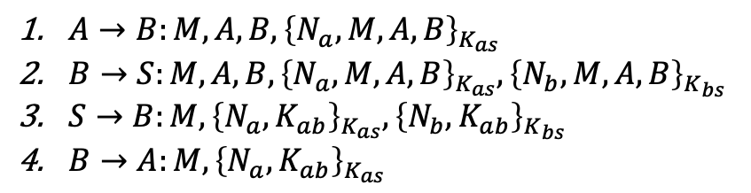
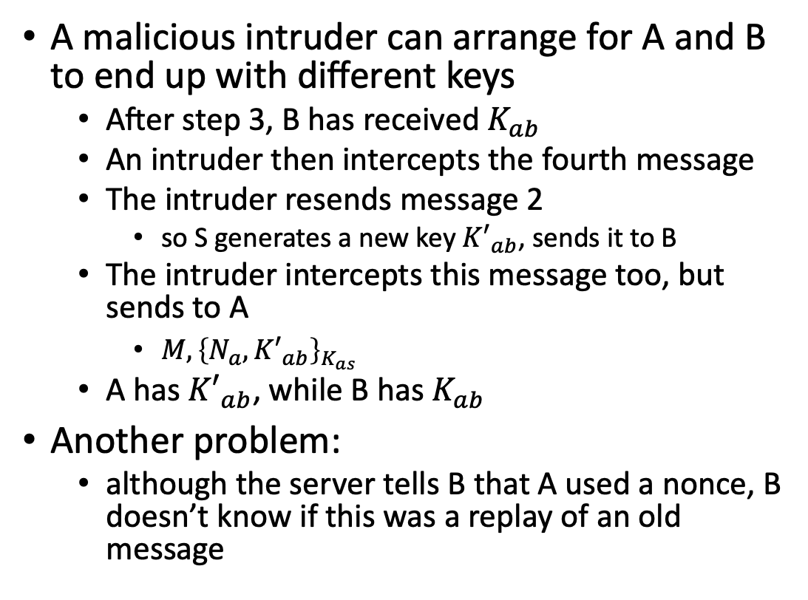
Otway-Rees protocol attack
A malicious intruder can arrange for A and B to end up with different keys
After step 3, B has received $K_{ab}$
An intruder then intercepts the fourth message
The intruder resends message 2
so S generates a new key ${K′}_{ab}$, sends it to B
The intruder intercepts this message too, but sends to A
${M, \left\{N_{a}, {K′}_{ab}\right\}}_{K_{as}}$
A has ${K′}_{ab}$, while B has $K_{ab}$
Another problem:
although the server tells B that A used a nonce, B doesn’t know if this was a replay of an old message
$A→B:M,A, B, {\left\{N_{a},M,A,B\right\}}_{K_{as}}$
$B→S:M,A, B, {\left\{N_{a},M,A,B\right\}}_{K_{as}},{\left\{N_{b},M,A,B\right\}}_{K_{bs}}$
$S→B:M,{\left\{N_{a},K_{ab}\right\}}_{K_{as}},{\left\{N_{b},K_{ab}\right\}}_{K_{bs}}$
$B→A:{M, \left\{N_{a}, K_{ab}\right\}}_{K_{as}}$

